Slide 1

Final Project
Team 4

Slide 2
Team members and contributions
Kan Zhang Program design and implementation
Linghao Du Implementation and Data validation
Yang Song Implementation and UML
Yiwei He Implementation, Slide and Presentation
Yuchen Bao Implementation and GUI
Xuliang Mei Implementation and GUI
We develop this project using Github.

Slide 3
Inventory and Personnel Project
Implemented with design patterns:
Singleton
Factory
Façade
Observer
MVC

Slide 4
Detailed Operating Instructions
To successfully execute the project:
Java 11+
JetBrain IntelliJ IDE (for GUI)
Copy the ‘/src’ folder into a project
Run main() in Driver.java and see the output and GUI.

Slide 5
Features of Project
Fulfill all the basic requirements in the slide
GUI (with Swing library)
Using CVS files to store data on the disk.
Data input validation.

Slide 6
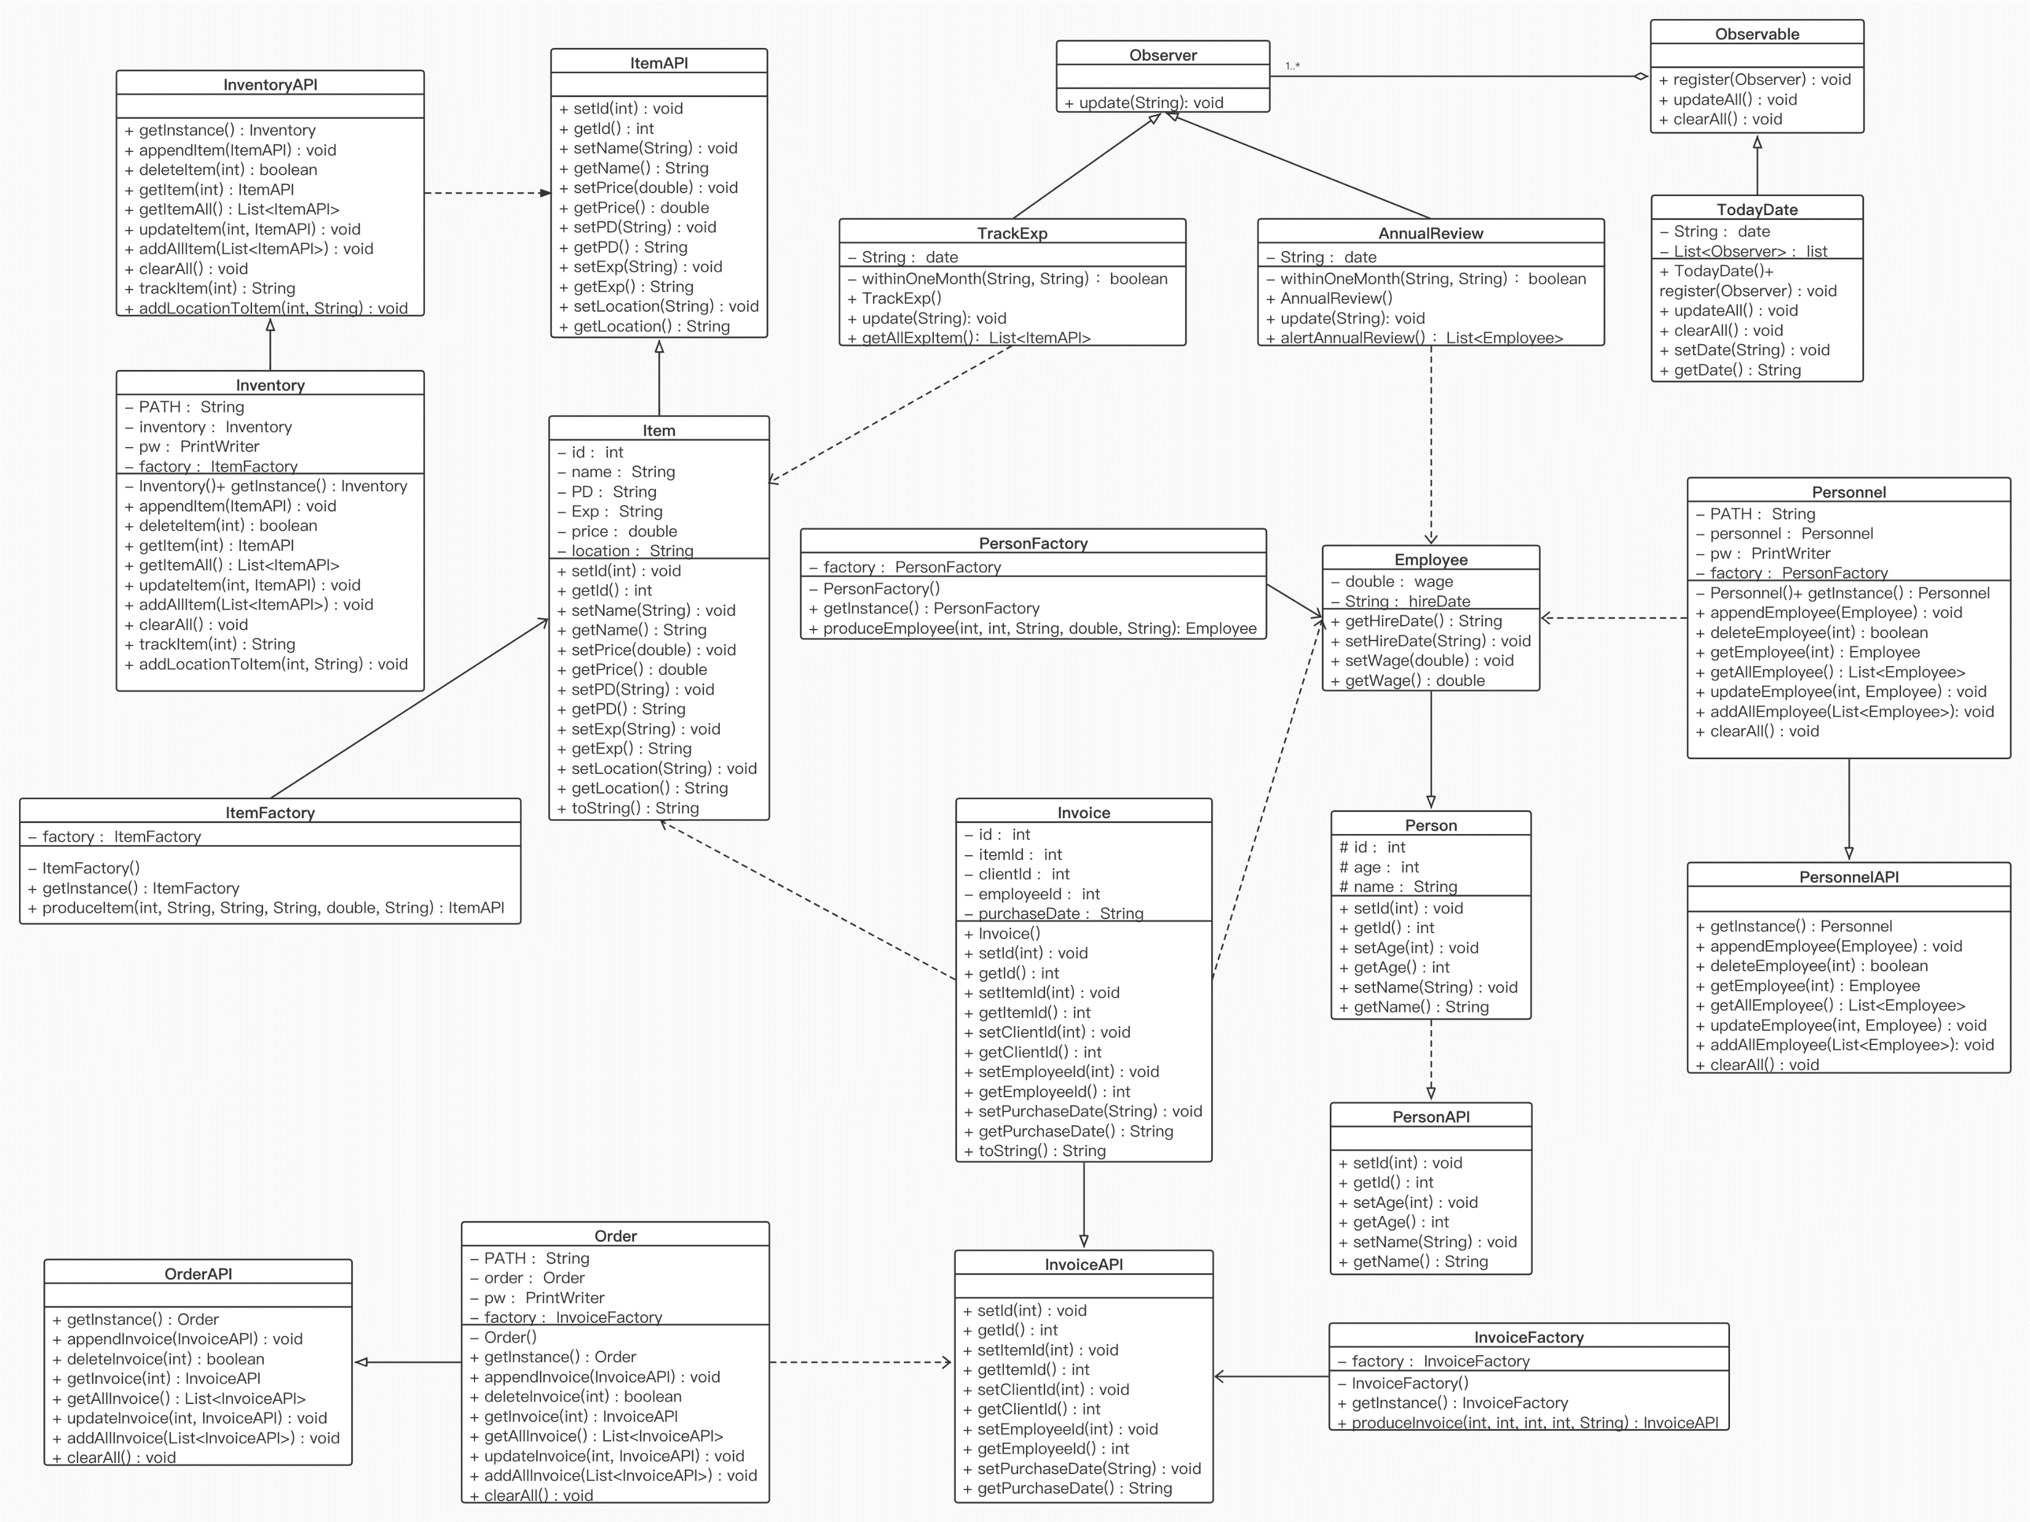
UML

Slide 7
Let’s see the code first!

Slide 8
Future Enhancement
Using Database and SQL to store the data.
Using more advanced design patterns
Adding more code for data validation in CRUD.

Slide 9
Thank you that’s all.

